Slide 1

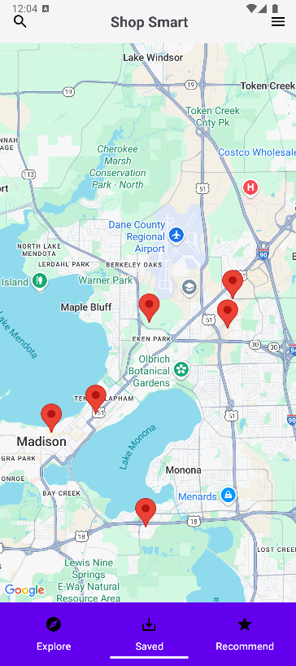
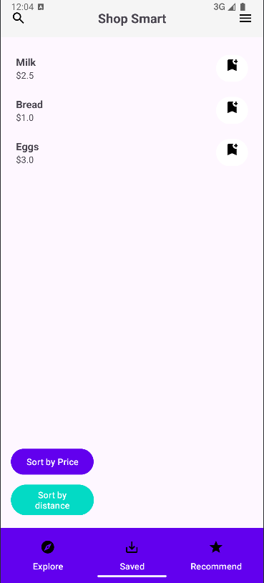
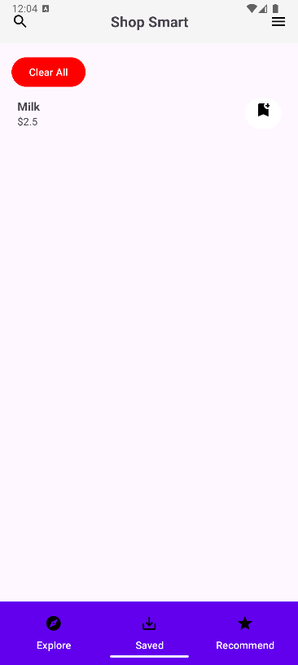
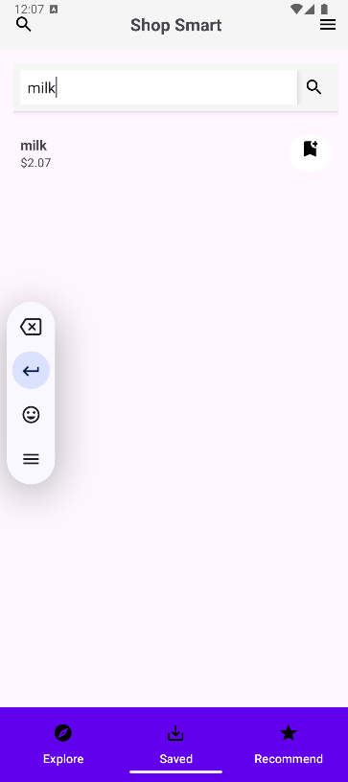
Shop Smart
He Chen, Kai Si, Yuchen Wang, Kamil atak
hchen736@wisc.edu, Ksi@wisc.edu, wang2673@wisc.edu, katak@wisc.edu
Tank-bot,idaydogday843,skf666,kamilatak3
CS407 Fall 2024 - Group Project
Introduction
ShopSmart is an Android-based shopping list app that helps users create grocery lists and provides real-time information on item prices, availability, and store locations.
Needs, Benefits: Saves time and effort by consolidating shopping list management with real-time store data. Offers price comparisons and availability checks to maximize savings. Includes notifications for timely shopping reminders
Natural Users: Busy people, parents, and urban dwellers who value convenience and efficiency.
Design: User Interface and Technology Stack
User-friendly design:
Integration with Android’s Material Design for a modern look.
Simple and intuitive navigation between features.
Unique design elements:
Background location services for nearest shop
Designed feature not from lab 01-09 :
server setup using node npm
Development Team
Yuchen Wang: Backend API integration and navigation flow implementation.
Kai Si: Sorting and saving function
He Chen: searching function and reports
Kamil Atak: Shop&Map integration and database setup.
Challenges and Solutions
Challenges:Implementing dynamic filters and integrating geolocation data. Managing real-time API calls without performance issues.
Adapting initial wireframes based on user feedback.
Solutions:Refined the filter system to prioritize user-friendliness.
Updated wireframes to improve navigation and add new features, such as category-specific search.
Design: Key Features
Navigation: Provide shortest route between user and his desired destination.
Search functionality: Supports text input for efficient product lookup.
Dynamic filters: Allows filtering by categories and sorting by price or popularity.
User Feedback/ Future Work
User Feedback:Suggestions to improve the visual appeal of the app.
Future Work:
Add images to product listings for better user experience.
Useful Links
ShopSmart Repository
Link to the demo video of your app

